Slide 1

Hibernate
Dima Ionut Daniel

Slide 2
Contents
What is Hibernate ?
Features
Architecture
Basics
Configuration
Mapping
Inheritance
Advanced
Conclussion
Bibliography

Slide 3

What is Hibernate ?
Hibernate ORM is an object-relational mapping framework written in Java .
Hibernate is free software that is distributed under the GNU Lesser General Public License.
Hibernate's primary feature is mapping from Java classes to database tables (and from Java data types to SQL data types).
Applications using Hibernate are portable to supported SQL databases with little performance overhead.

Slide 4
Features
Mapping Java classes to database tables is accomplished through the configuration of an XML file or by using Java Annotations.
One-to-many and many-to-many relationships between classes are supported.
Hibernate provides an SQL inspired language called Hibernate Query Language (HQL).
Criteria Queries are provided as an object-oriented alternative to HQL.
Hibernate supports the mapping of custom value types:
Overriding the default SQL type that Hibernate chooses when mapping a column to a property.
Mapping Java Enum to columns as if they were regular properties.
Mapping a single property to multiple columns

Slide 5
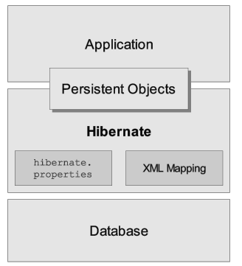
Architecture
High-level view of the Hibernate architecture

Slide 6
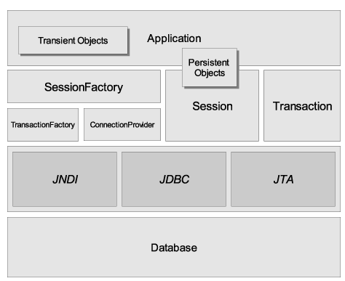
Architecture (cont.)
Hibernate architecture

Slide 7
Basics
To create a connection to the database, Hibernate must know the details of our database, tables, classes, etc.
The information is provided as an XML file (usually named hibernate.cfg.xml) or as a simple text file with name/value pairs (usually named hibernate.properties).
Sample hibernate configuration:
<hibernate-configuration>
<session-factory>
<property name="connection.url">jdbc:mysql://localhost:3306/cinema</property>
<property name="connection.driver_class">com.mysql.jdbc.Driver</property>
<property name="connection.username">user</property>
<property name="connection.password">password</property>
<property name="dialect">org.hibernate.dialect.MySQL5Dialect</property>
<mapping resource="Movie.hbm.xml" />
</session-factory>
</hibernate-configuration>

Slide 8
Basics (cont.)
The mapping files indicates the mapping of object properties to the row column values.
This mapping is done in a separate file, usually suffixed with .hbm.xml.
Sample mapping file:
<hibernate-mapping>
<class name="com.domain.Movie" table="MOVIES">
<id name="id" column="ID">
<generator class="native"/>
</id>
<property name="title" column="TITLE"/>
<property name="director" column="DIRECTOR"/>
<property name="plot" column="PLOT"/>
</class>
</hibernate-mapping>

Slide 9
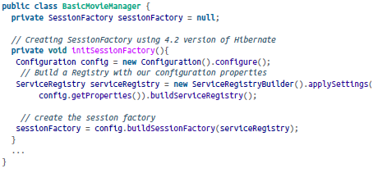
Basics (cont.)
The Hibernate loads the configuration file to create a SessionFactory, which is a threadsafe global factory class for creating Sessions.
The goal of the SessionFactory is to create Session objects, which are like gateways to the database.
The Session’s job is to take care of all database operations such as saving, loading, and retrieving records from relevant tables.
Session objects are not thread-safe and therefore should not be shared across different classes.

Slide 10
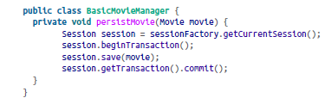
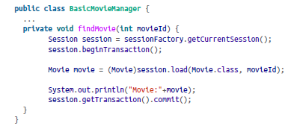
Basics (cont.)
Basic operation examples:

Slide 11
Configuration
An instance of org.hibernate.cfg.Configuration represents an entire set of mappings of an application's Java types to an SQL database.
The org.hibernate.cfg.Configuration is used to build an immutable org.hibernate.SessionFactory.
You can obtain a org.hibernate.cfg.Configuration instance by instantiating it directly and specifying XML mapping documents.
Examples:
Configuration cfg = new Configuration().addResource("Item.hbm.xml").addResource("Bid.hbm.xml");
Configuration cfg = new Configuration().addClass(Item.class).addClass(Bid.class);

Slide 12
Configuration (cont.)
We can obtain SessionFactory from Configuration object.
SessionFactory sessions = cfg.buildSessionFactory();
From SessionFactory we can obtain the Session object.
Session session = sessions.openSession(); // open a new Session

Slide 13
Mapping
To make this class persistent using annotations, we define it as an @Entity.
We use the @Id annotation to indicate the object’s identifier to the framework.
The @Table annotation is used on the class to indicate the SQL table.
@Column annotation is used on fields to indicate the SQL column from the tab

Slide 14
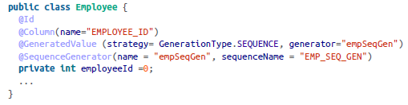
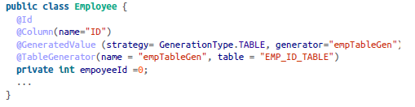
Mapping (cont.)
Hibernate provides various identifier generation strategies. Default strategy is AUTO.
When the strategy is AUTO, Hibernate relies on our database to generate primary keys.
@GeneratedValue is used to indicate the identifier strategy.
Other possible values are: IDENTITY, AUTO, SEQUENCE, TABLE.

Slide 15
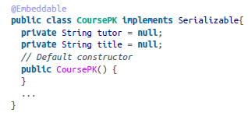
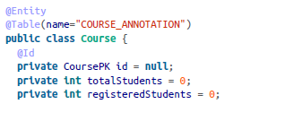
Mapping (cont.)
We don’t always have a single column (surrogate key) as our primary key identifying the unique row.
We define a class containing the primary key with @Embeddable and we define the id field with @Id.

Slide 16
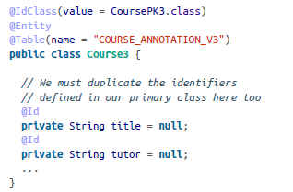
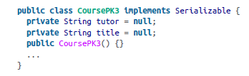
Mapping (cont.)
We can define the primary class with @EmbeddedId and we don't need to define the @Embeddable on the primary key class.
Another way to define the primary key is using the @IdClass annotation that will refer the composite primary key class.
We need to duplicate the composite key identifiers using this method and must be decorated with @Id.

Slide 17
Mapping (cont.)
Any time you see a @OneToOne, @OneToMany or @ManyToMany annotations, we’ve got a relationship.
The default fetch type is FetchType.LAZY.
FetchType.LAZY = Doesn’t load the relationships unless explicitly "asked" via getter
FetchType.EAGER = Loads ALL relationships

Slide 18
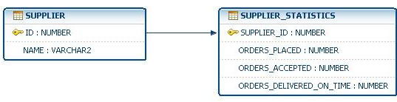
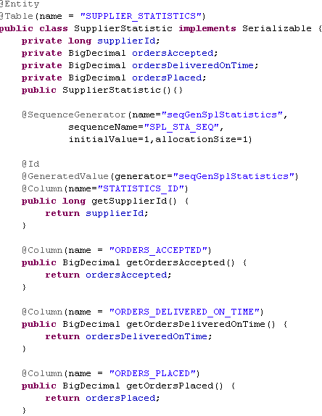
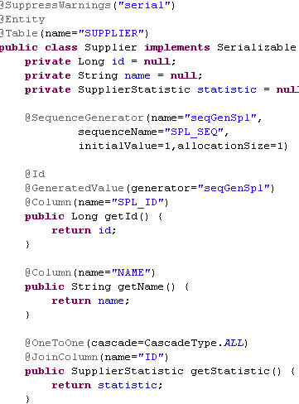
Mapping (cont.)

Slide 19
Mapping (cont.)
@JoinColumn is used to specify the foreign key used to associate entities.
@PrimaryKeyJoinColumn specifies the primary key used as foreign key to link to another table.
CascadeType is used to define a set of cascade operations: ALL, PERSIST, MERGE, REMOVE, REFERSH.
@JoinTable can be used to specify the ownership of many-to-many association or unidirectional association for one-to-many relationship.

Slide 20
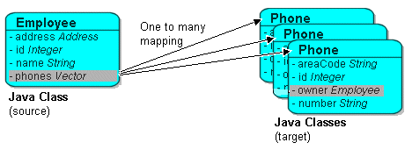
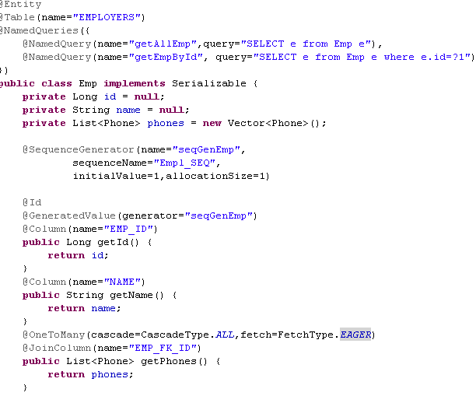
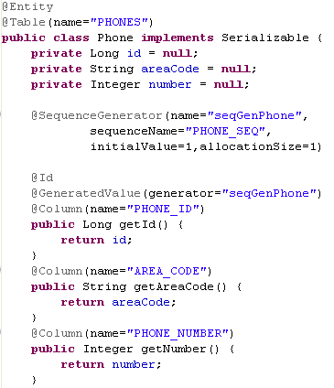
Mapping (cont.)

Slide 21
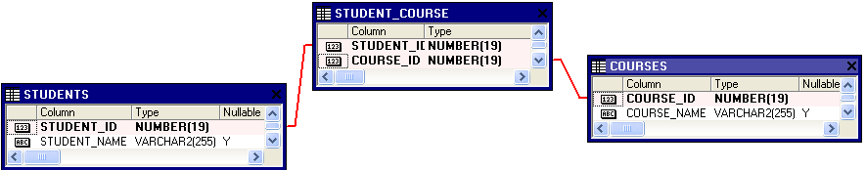
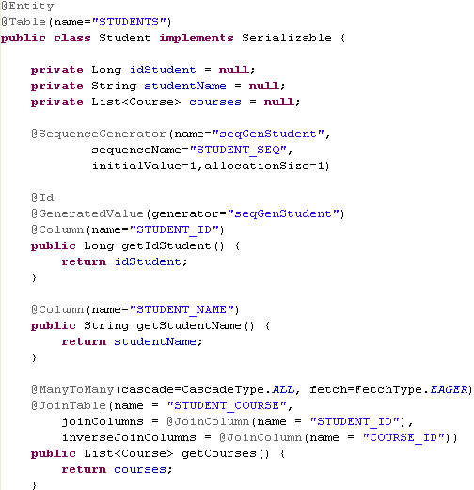
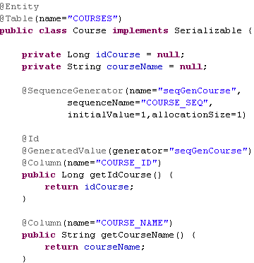
Mapping (cont.)

Slide 22
Mapping (cont.)
@Enumerated → specifies the enumeration value and can be stored as ORDINAL or STRING based on EnumType.
@Temporal → can be used to Date or Calendar data type based on TemporalType value: DATE, TIME, TIMESTAMP.
@Basic →simples annotation for column
@Lob → used for LOB data type in conjunction with @Basic annotation.

Slide 23
Inheritance
We can create inheritance between entities.
There are 3 strategies:
table per single class
table per concrete class
JOINED strategy
@Inheritance is used to define the strategy and it's specified on parent class.
@DiscriminatorColumn is used to define discriminator column for SINGLE_TABLE and JOINED strategies.
@DiscriminatorValue specifies the value for discriminator column.

Slide 24
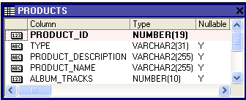
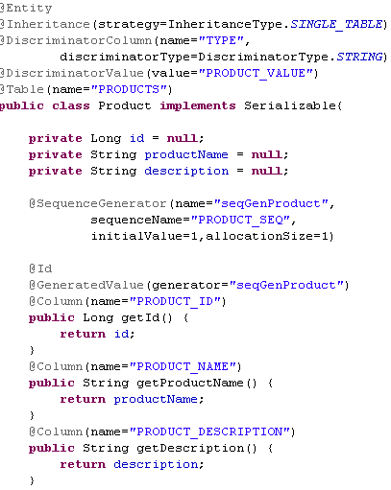
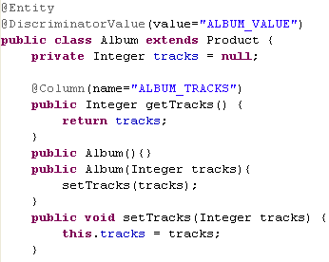
Inheritance (cont.)

Slide 25
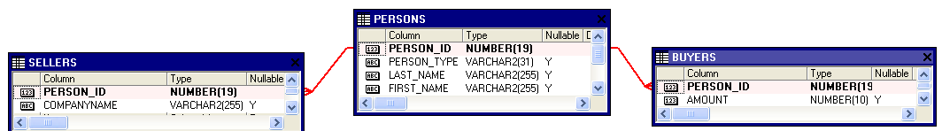
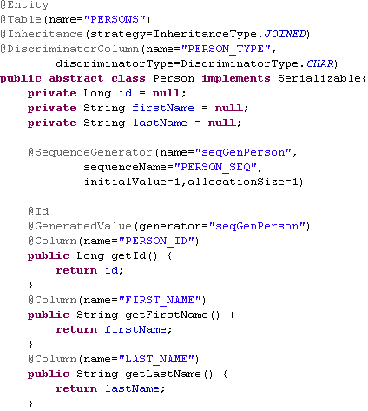
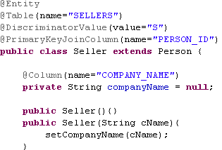
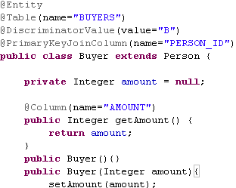
Inheritance (cont.)

Slide 26

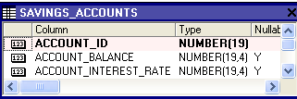
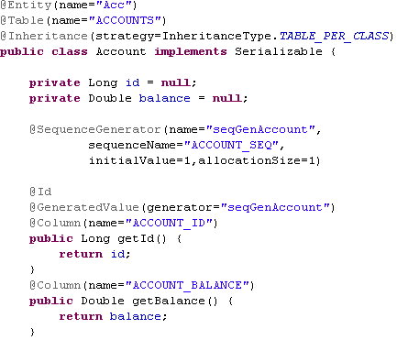
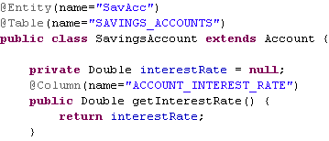
Inheritance (cont.)

Slide 27
Inheritance (cont.)
Feature | Single Table | Joined Tables | Table per Class
Table support | Mandatory fields can be null. Table can increase if multiple subclasses are added. | One for every parent and one per subclass to store polymorph properties. | Table per every entity from hierarchy.
Discriminator column | Yes | Yes | No
SQL select | Simple SELECT | SELECT with joins between multiple tables | One SELECT per every subclass
Polymorph relations | Good | Good | Bad
Polymorph queries | Good | Good | Bad
JPA support | Mandatory | Mandatory | Optional

Slide 28
Advanced
Hibernate supports caching of persistent objects using first-level and second-level caching methods.
The first level is simply the transactional cache associated with the Session object, which is available during the lifespan of that session or in the conversation only.
The second-level cache is globally available via the SessionFactory class.
Any data present in this cache is made available to the entire application.
Hibernate supports a few open source cache implementations: EhCache and InfiniSpan.
<hibernate-configuration>
<session-factory>
<property name="hibernate.cache.provider_class">
org.hibernate.cache.infinispan.InfinispanRegionFactory
</property>
</session-factory>
</hibernate-configuration>

Slide 29
Advanced (cont.)
We can set the caching policy on individual classes that need to be cached by using various caching attributes.
Usage attribute can have following values:
transactional: provides support for cache implementation providers that support transactional caching.
read-only: in case we have frequent reads of persistent objects.
read-write: enables both reading and writing of the objects
nonstrict-read-write: objects are not updated that often
<hibernate-mapping package="com.example">
<class name="Person" table="PERSON">
<cache usage="read-write" region="" include="all"/>
...
</class>
</hibernate-mapping>

Slide 30
Advanced (cont.)
We can cache queries also.
To use this functionality we need to set the hibernate.cache.use_query_cache attribute to true.
Also in the code se need to set the cacheable property on the Query.

Slide 31
Advanced (cont.)
Hibernate has its own query language, called the Hibernate Query Language (HQL) designed for querying Java object models.
Hibernate provides a Query API to use with object-relational queries.
Query query = session.createQuery("from TravelReview");
List<TravelReview> reviews = query.list();
for (TravelReview travelReview : reviews) {
System.out.println("Travel Review: " + travelReview);
}

Slide 32
Advanced (cont.)
We can use the built-in pagination support by invoking setMaxResults with our bounds:
Query query = session.createQuery("from TravelReview");
query.setMaxResults(100);
query.setFirstResult(10);
List<TravelReview> reviews = query.list();
We can set named parameters to the Query:
Query query = session.createQuery("from TravelReview where title=:titleId and id=:reviewId");
query.setString("titleId", "London");
query.setInteger("reviewId",1);

Slide 33
Advanced (cont.)
The Query API also supports positional parameters:
Query query = session.createQuery("from TravelReview where title=? and id=?");
// title at 0th place
query.setString(0, "London");
// id at 1st place
query.setInteger(1,1);

Slide 34
Advanced (cont.)
The SELECT operator in HQL works along the same lines as in SQL.
Query query = session.createQuery("SELECT tr.review from TravelReview as tr");
// Each review is a long description in String format
List<String> reviews = query.list();

Slide 35
Advanced (cont.)
A criteria is a mechanism through which we set our query conditions on the entity itself.
Hibernate provides us a Criteria class along with another class, Restrictions, filtering conditions.
Criteria criteria = session.createCriteria(TravelReview.class);
List review = criteria.add(Restrictions.eq("title", "London")).list();
System.out.println("Using equals: " + review);

Slide 36
Advanced (cont.)
Criteria criteria = session.createCriteria(TravelReview.class)
.add(Restrictions.eq("author", "John Jones"))
.add(Restrictions.between("date",fromDate,toDate))
.add(Restrictions.ne("title","New York"));
// Getting row count
review = session.createCriteria(TravelReview.class)
.setProjection(Projections.rowCount()).list();

Slide 37
Advanced (cont.)
We can use the @NamedQuery annotation to bind the queries on the entity at a class level, or we can declare them in our mapping files.
In both methods, the named queries are retrieved from the session.
@Entity(name = "TRAVEL_REVIEW")
@NamedQueries( value = {
@NamedQuery(name = "GET_TRAVEL_REVIEWS", query = "from TravelReview"),
@NamedQuery(name = "GET_TRAVEL_REVIEWS_FOR_TITLE", query = "from TravelReview where id=:title")
})
public class TravelReview implements Serializable { ... }
// Fetch the predefined named query
Query query = session.getNamedQuery("GET_TRAVEL_REVIEWS");
List reviews = query.list();

Slide 38
Advanced (cont.)
Hibernate also provides a feature to execute native SQL queries.
The session.createSQLQuery method returns a SQLQuery object, similar to how create Query returns a Query object.
SQLQuery query = session.createSQLQuery("select * from NATIVESQL_EMPLOYEE");
List employees = query.list();

Slide 39
Conclussion
PROS:
Portability
Maintainability
Free
Popular
Documented

Slide 40

Bibliography
https://en.wikipedia.org/wiki/Hibernate_%28Java%29
Oreilly – Just Hibernate
http://docs.jboss.org/hibernate/orm/4.3/manual/en-US/html

Slide 41
Questions ?

